Slide 1
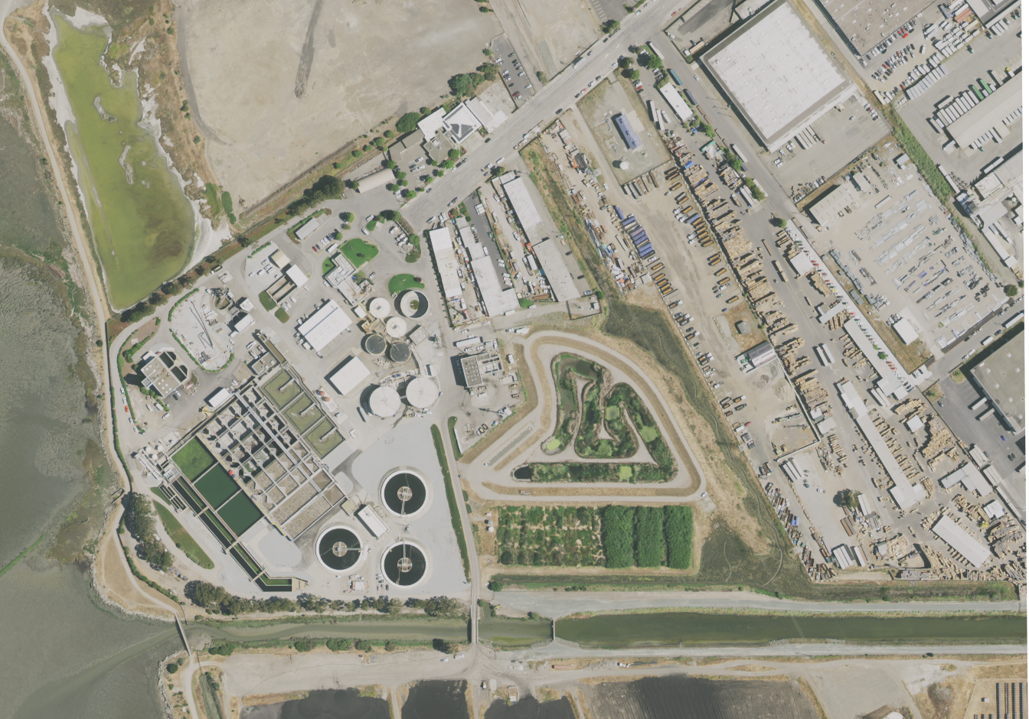
Wastewater Treatment Plant Project
Team Members:
Pooja Kabber
Sukhpreet Sahota
Dingkun Yang
Yuanjing Zhu
Client:
Dr. Christine Kirchhoff (Penn State Uni.)
Mentor:
Dr. Kyle Bradbury (Duke Uni.)

Slide 2
Outline
Updates on model building
Datasets exploration and integration
Plan for the rest of this semester
Deliverables

Slide 3
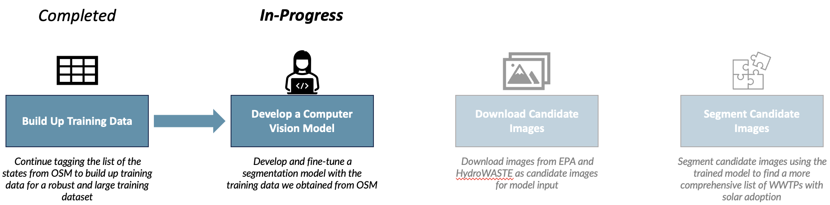
WWTP Analysis Process

Slide 4



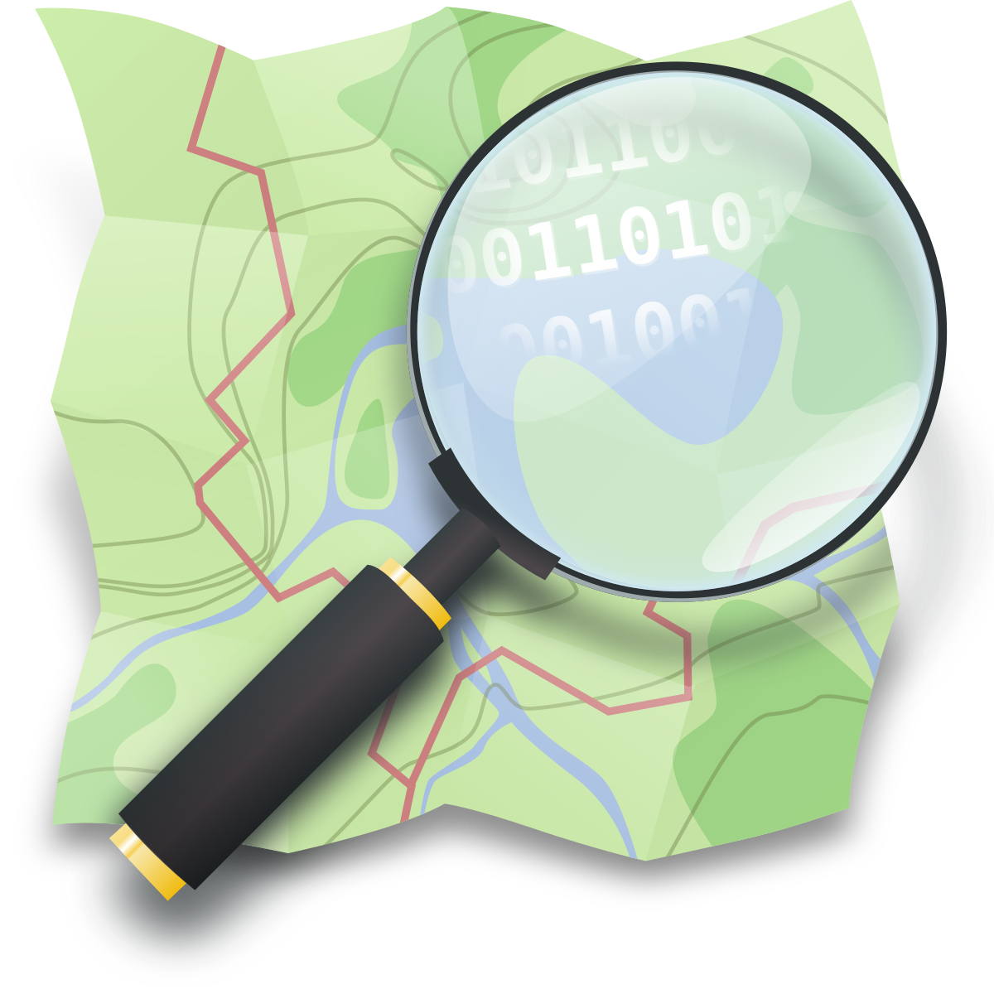


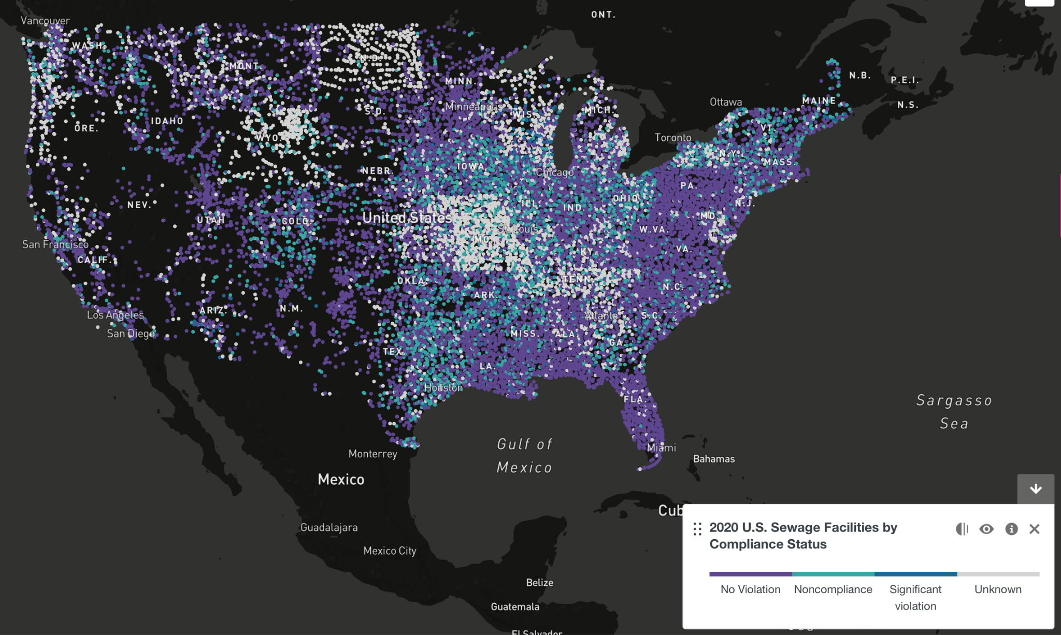
Data Sources
HydroWaste
Approved List of 40 Solar Verified WWTP3
OpenStreetMap
EPA

Slide 5
Using computer vision to automate the detection of WWTP sites

Slide 6
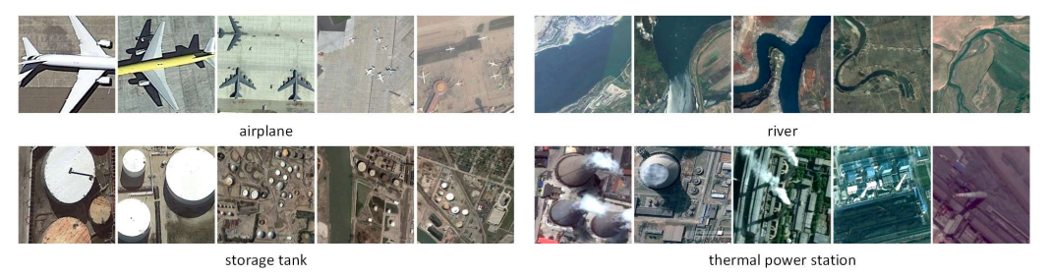
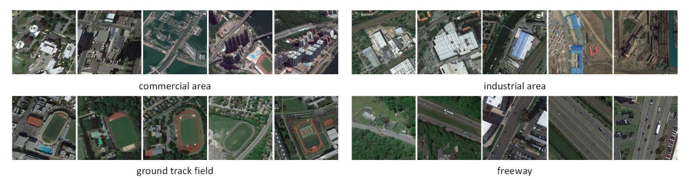
Scene Classification
Utilize computer vision algorithm
Cheng, G., Xie, X., Han, J., Guo, L., & Xia, G.-S. (2020). Remote Sensing Image Scene Classification Meets Deep Learning: Challenges, Methods, Benchmarks, and Opportunities. IEEE Journal of Selected Topics in Applied Earth Observations and Remote Sensing, 13, 3735–3756.

Slide 7
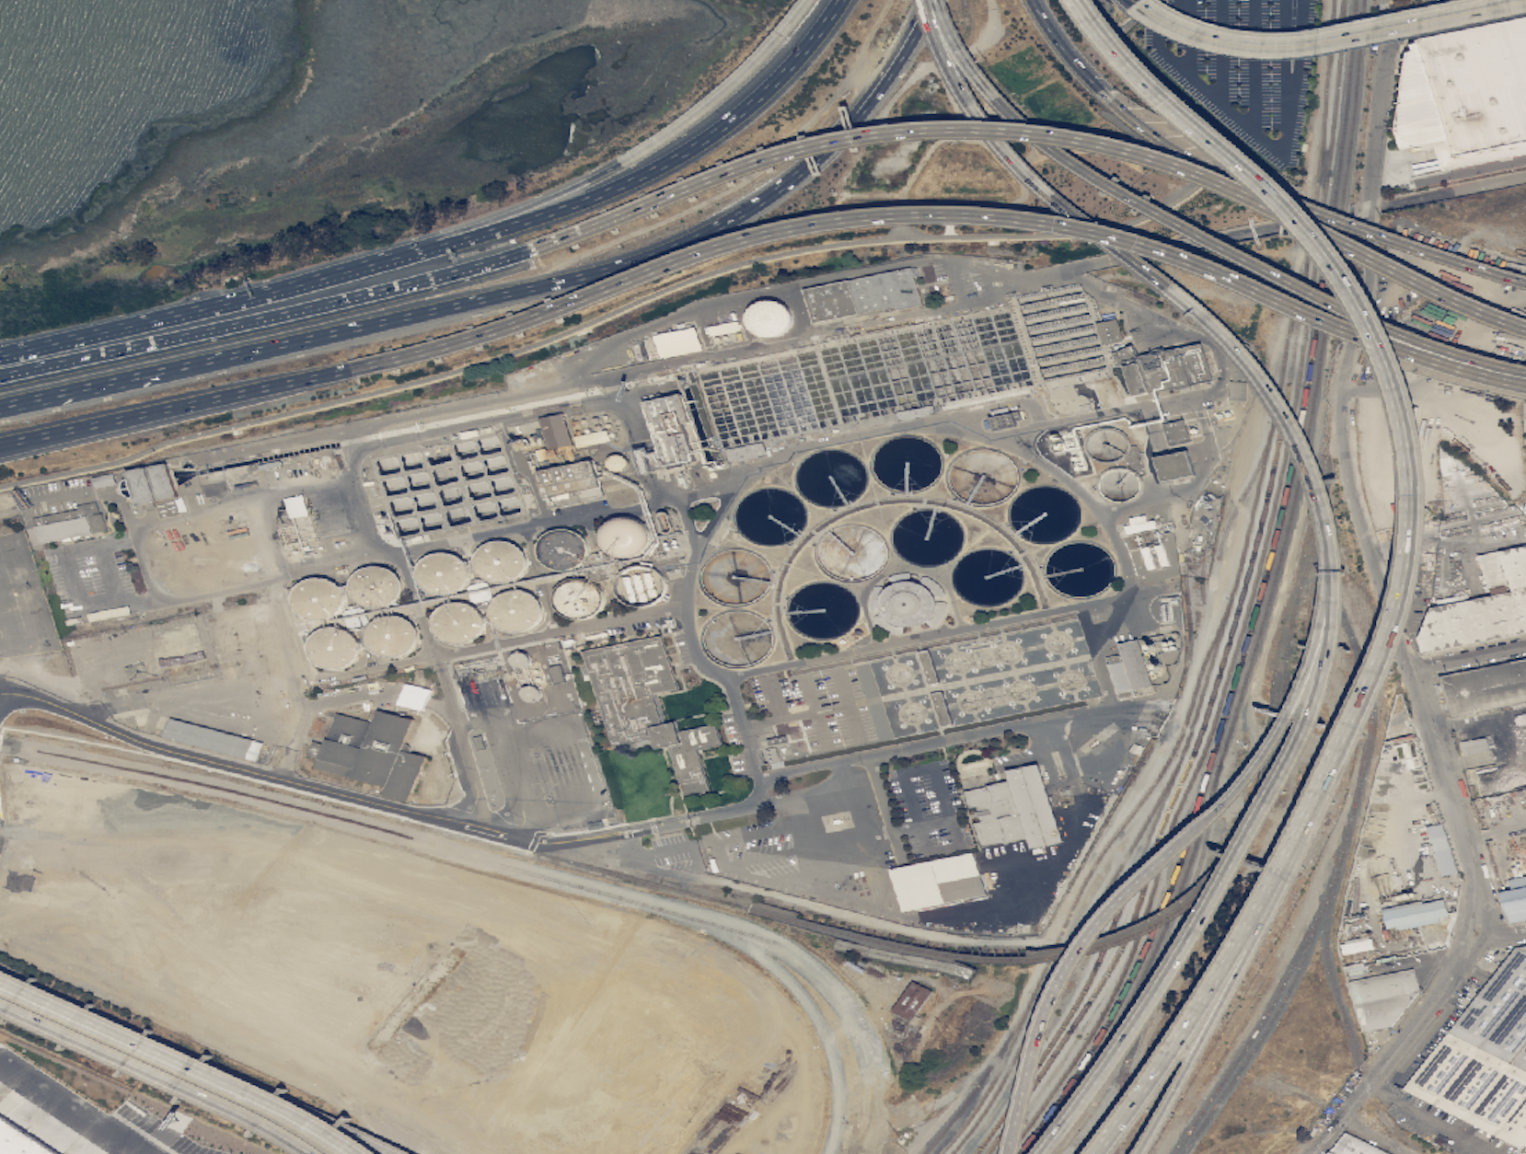
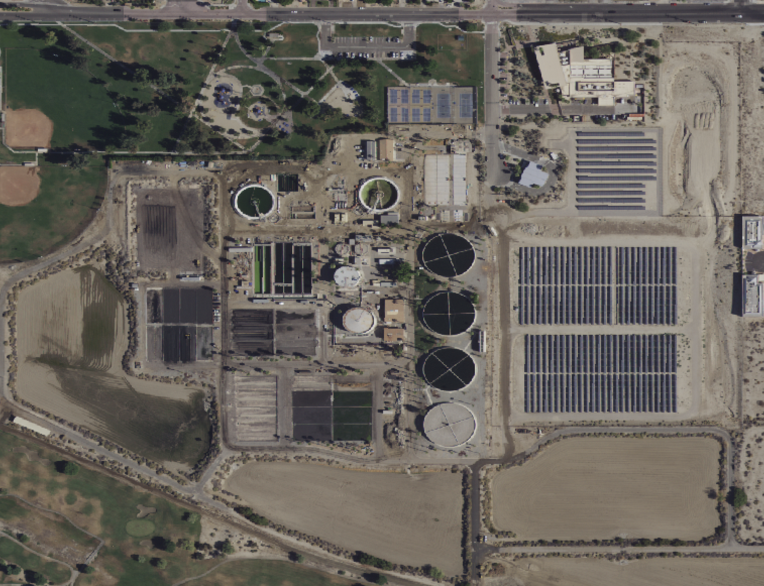
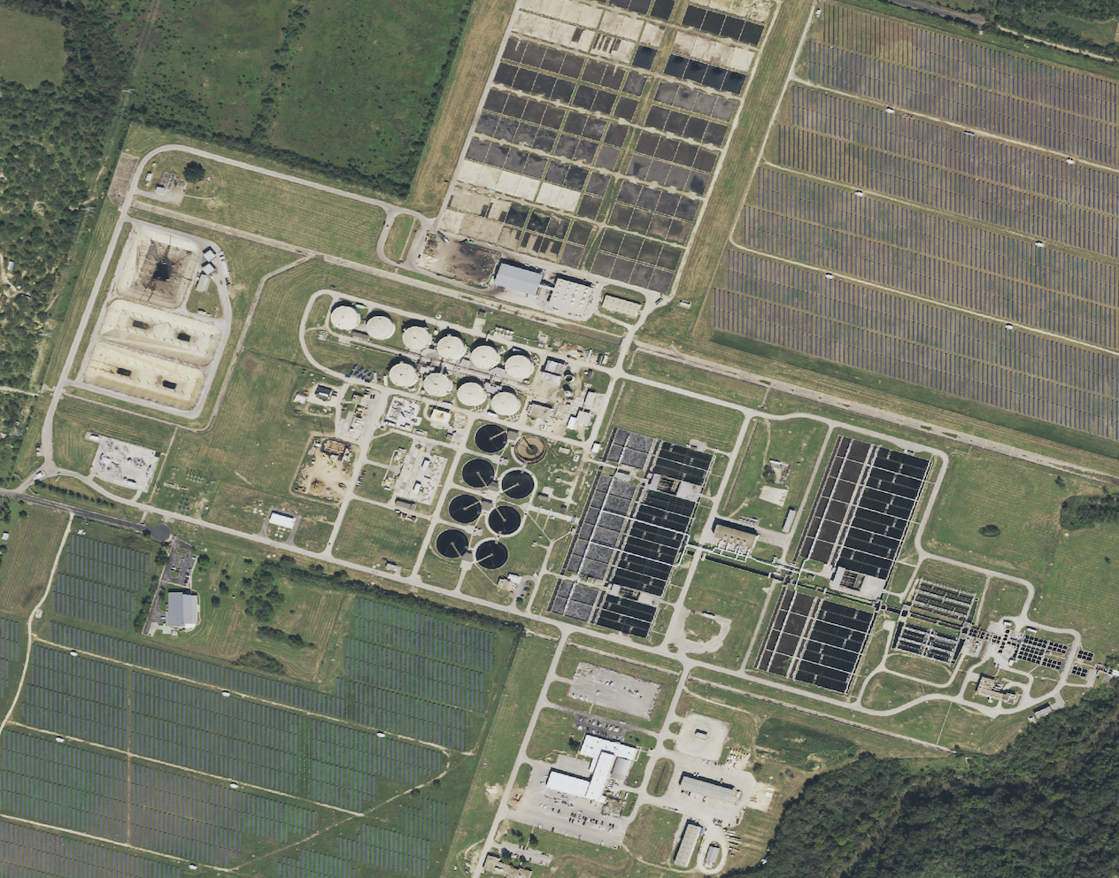
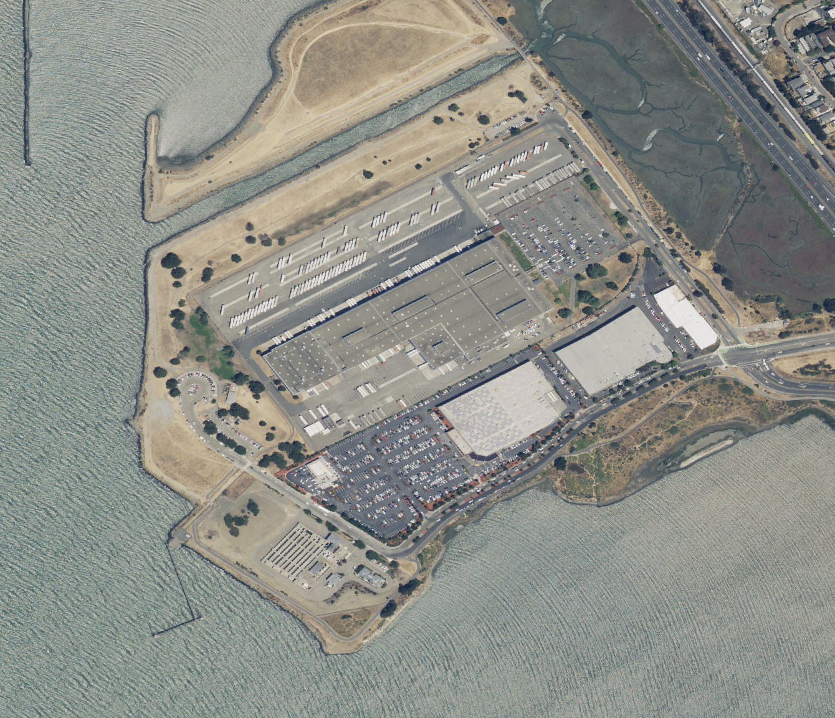
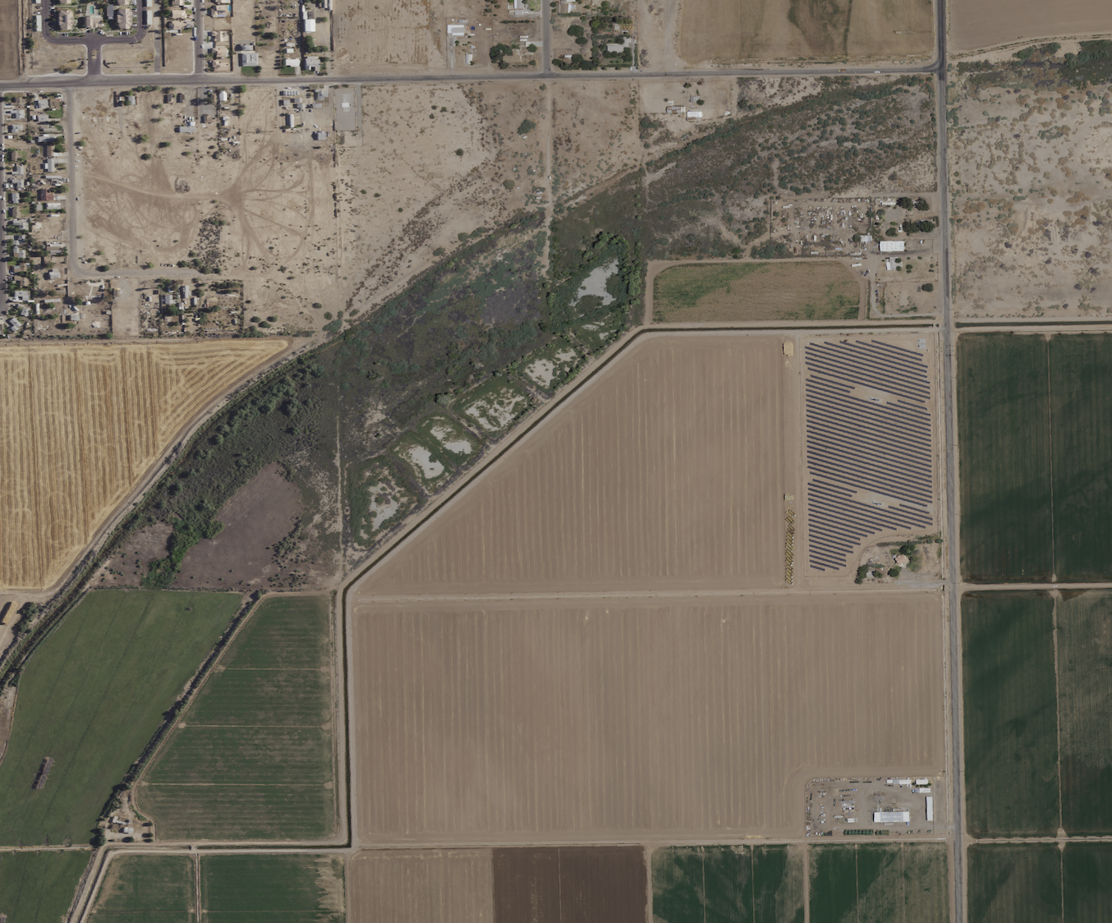
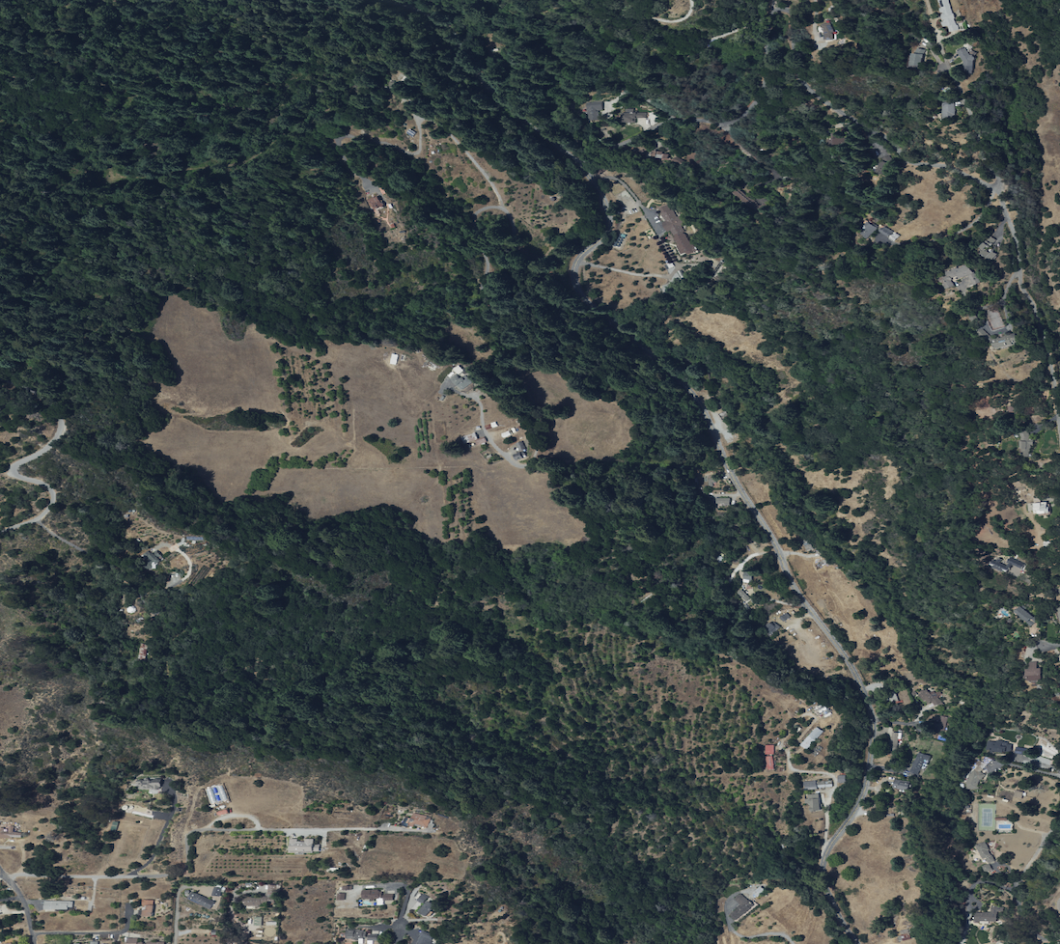
Scene Classification
Binary Classification: WWTP or Not

Slide 8
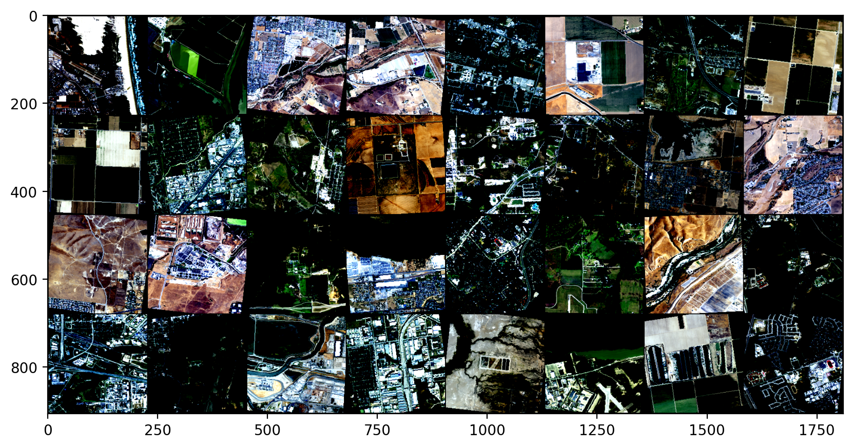
Data Pre-processing
Resize to 224 x 224 pixels from 2228 x 2228
Convert to tensor
Normalize
μ = [0.485, 0.456, 0.406]
σ = [0.229, 0.224, 0.225]
Random flip
Random rotation
Training Data Preview

Slide 9

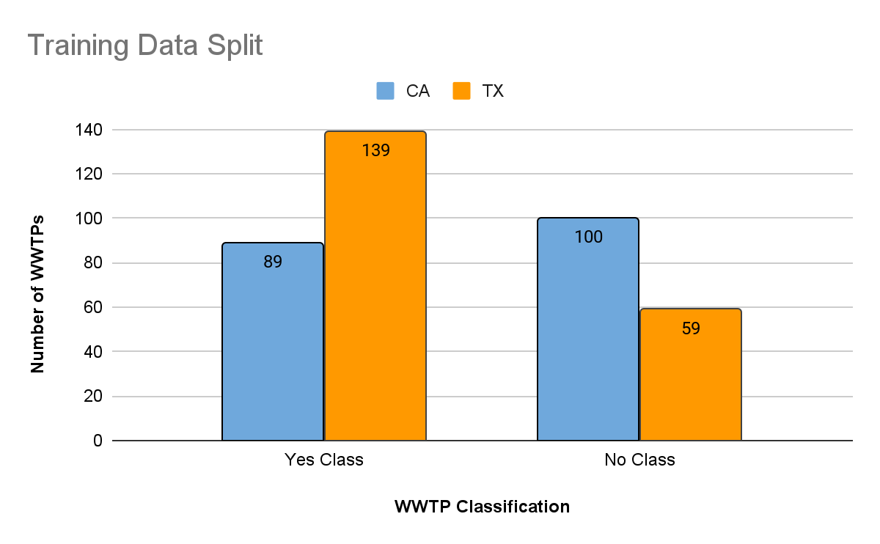
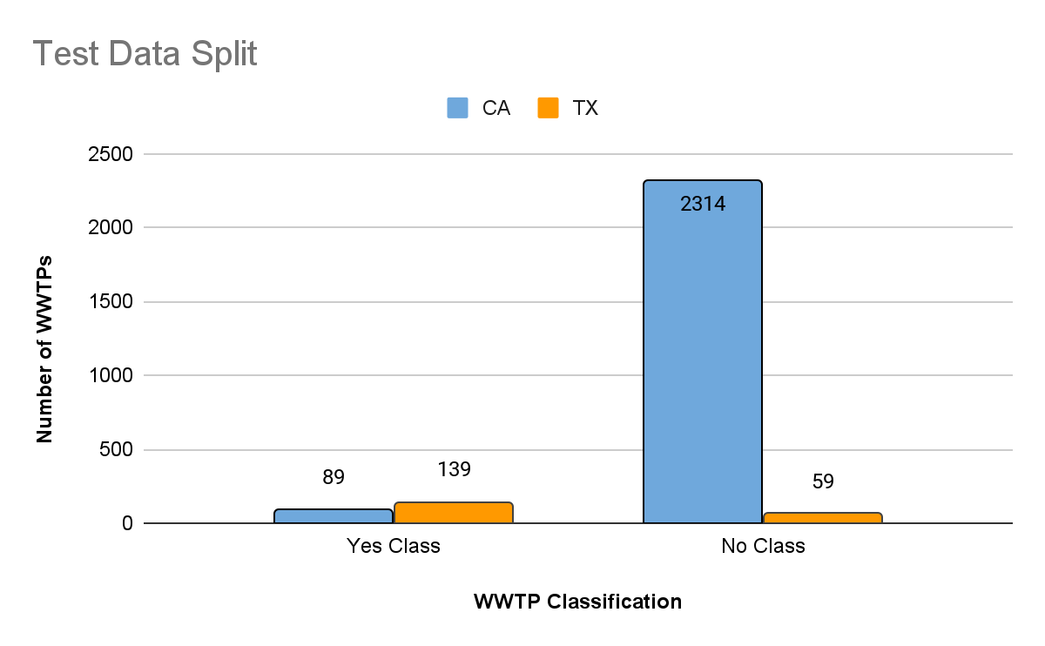
Data Loading
Randomized Split to achieve “balanced” data
228
2,373
159
228
Notes:
YES[Train: CA 89 TX 139; Test CA 89 TX 139;]
NO[Train: CA 100 TX 59; Test CA 2314 TX 59]

Slide 10
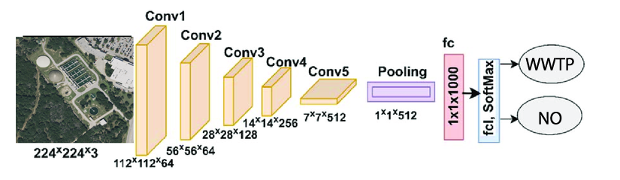
Model
Pre-trained ResNet-18 from Deep Residual Learning for Image Recognition on ImageNet
Residual Network-18: a convolutional neural network that is 18 layers deep

Slide 11
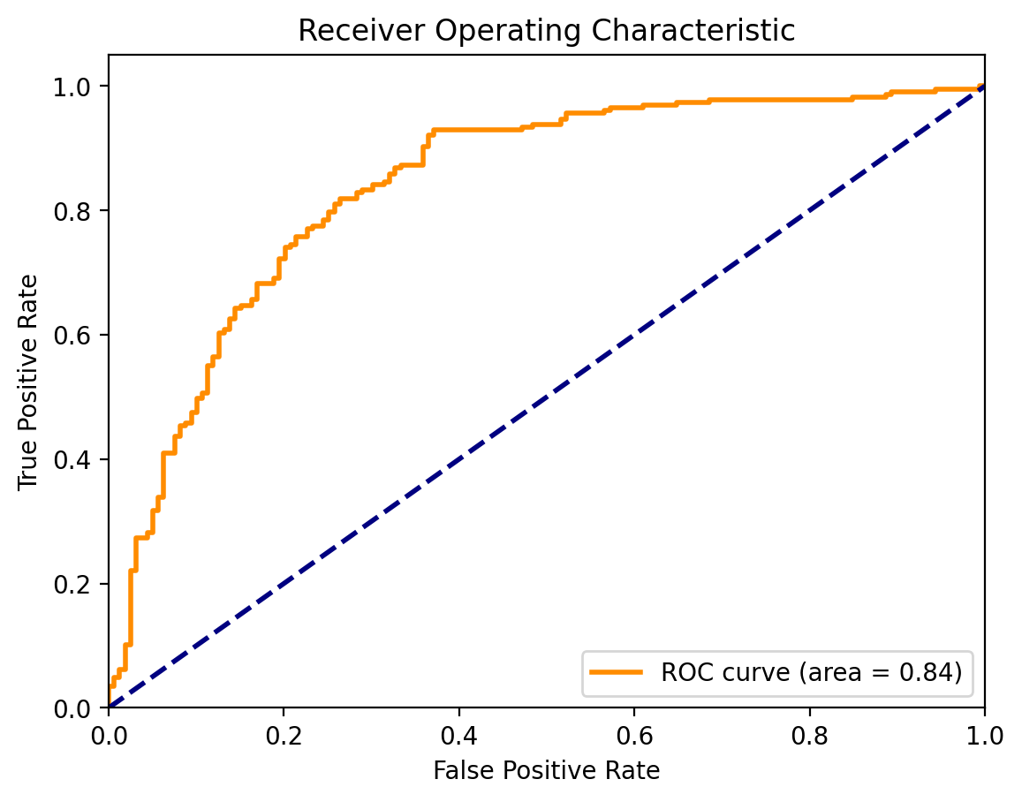
Fine-Tuned Training
17 epochs
Precision: 0.7951
Recall: 0.7679
F1 Score: 0.7747
Accuracy 79.02%

Slide 12
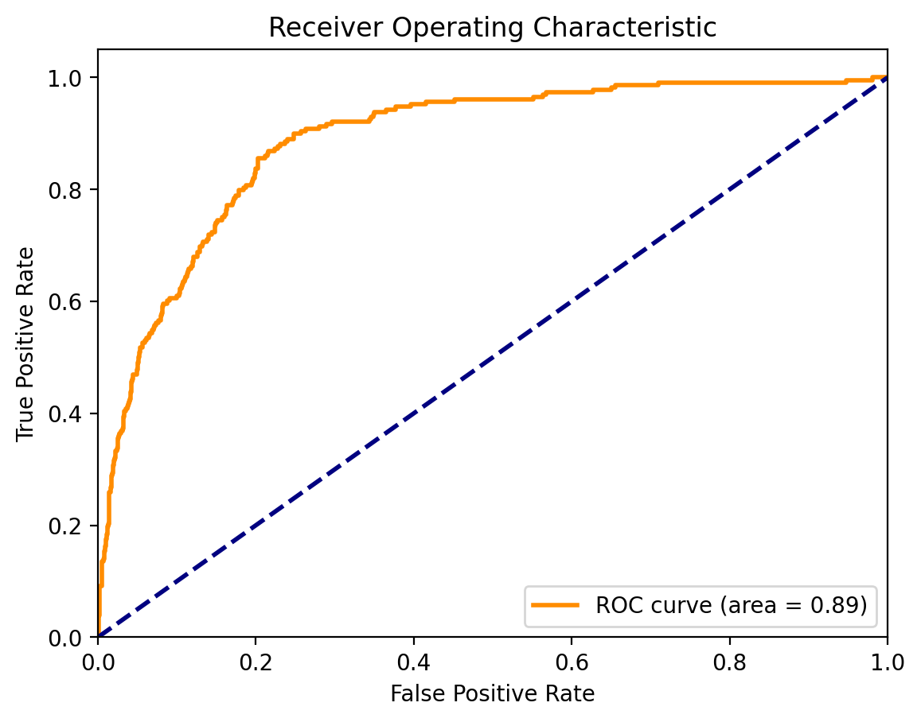
Testing
Precision: 0.6320
Recall: 0.8227
F1 Score: 0.6497
Accuracy: 79.59%
Comparing to Training
Precision: 0.7951
Recall: 0.7679
F1 Score: 0.7747
Accuracy 79.02%

Slide 13
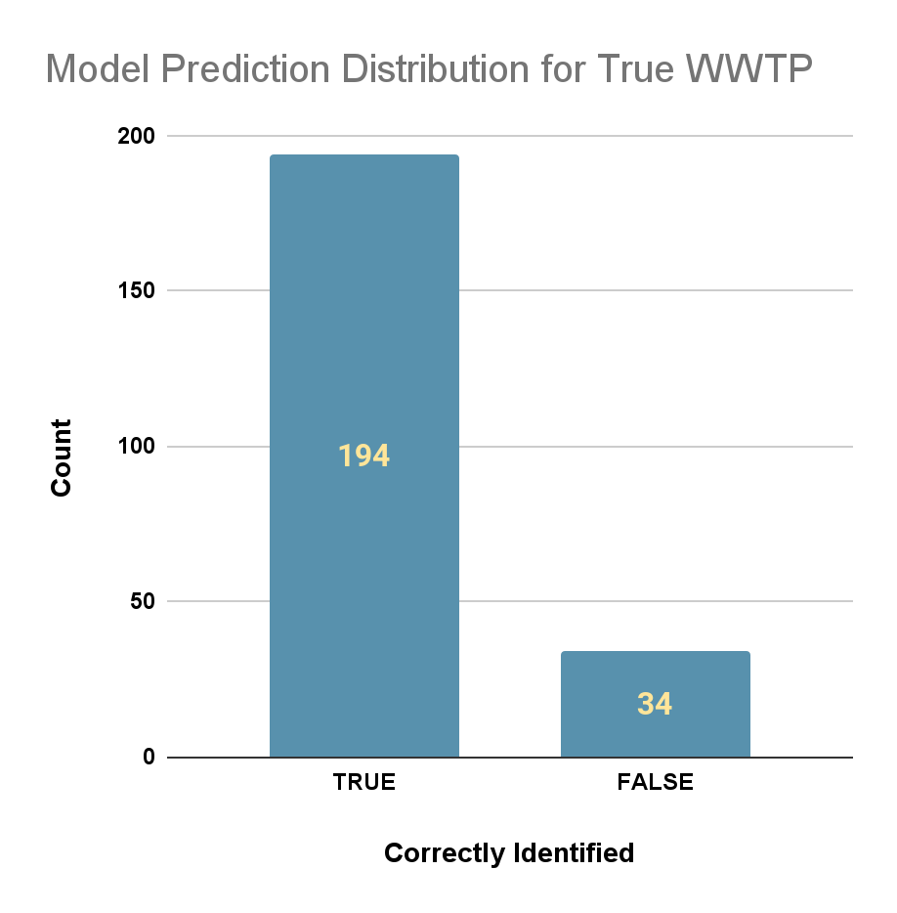
Inference Examples
Spreadsheet
Correctly Identified:
Town of Flower Mound - Wastewater Treatment
Plant_1013504981
City of Redlands Wastewater Treatment and Disposal Facility
Plant_906725619
Failed to identify:
Anderson Wastewater Treatment Plant
Tahoe-Truckee Sanitation Agency
Recall Rate: 0.85
 | Predicted Correctly
Ground Truth | Correct | Wrong | Grand Total
WWTP | 194 | 34 | 228
Not WWTP | 1880 | 493 | 2373
Grand Total | 2074 | 527 | 2601

Slide 14
To improve the comprehensiveness of our WWTP list, the computer vision model will be applied on selected candidate images.

Slide 15
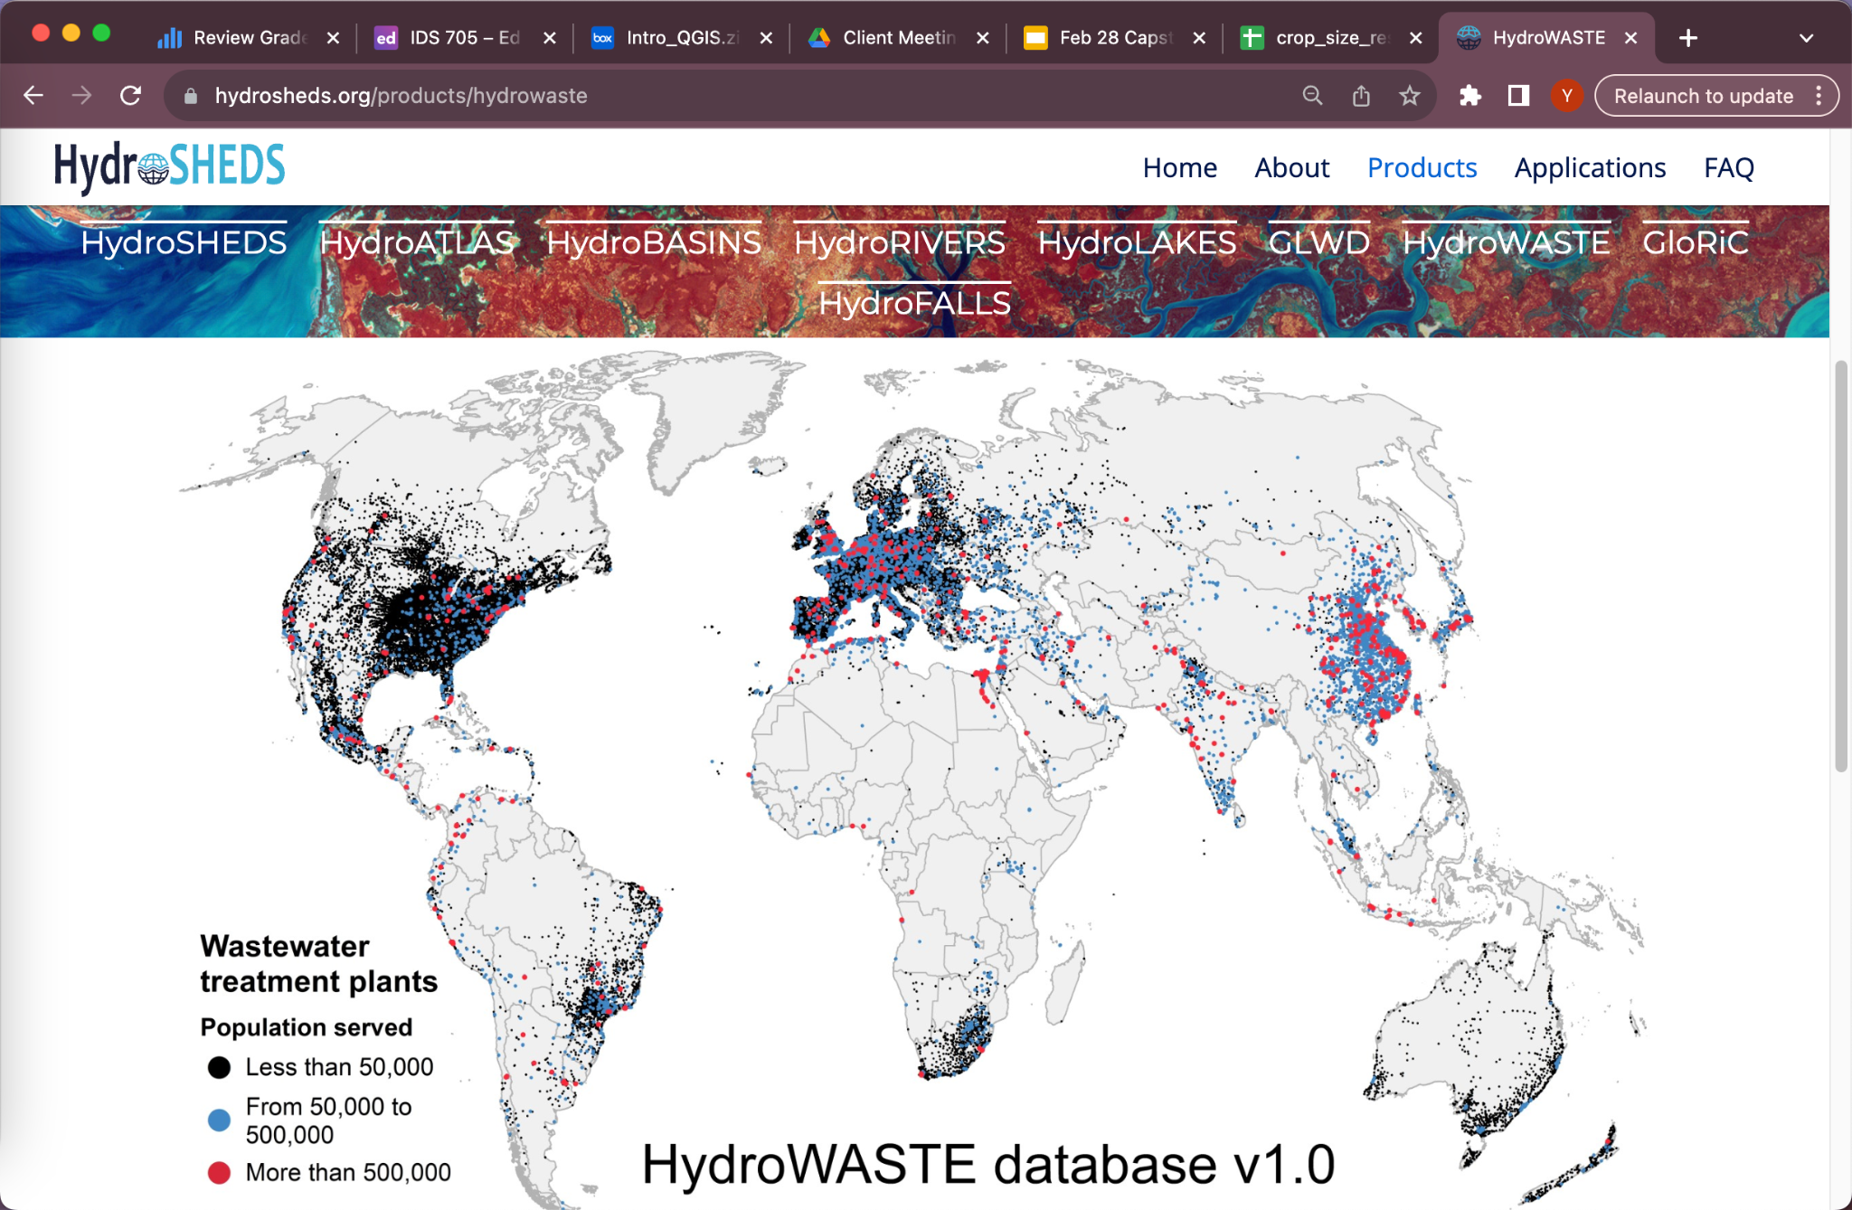
HydroWASTE - Newly discovered dataset
https://www.hydrosheds.org/products/hydrowaste
HydroWASTE is a global database of 58,502 WWTPs and their characteristics.
It combines national and regional datasets with auxiliary information to fill in missing data such as the number of people served, effluent flow rates, and treatment levels.
For the United States, the data source comes from the 2012 version of The Clean Watersheds Needs Survey conducted by the US Environmental Protection Agency (EPA), supplemented by the Enforcement and Compliance History Online (ECHO) system

Slide 16
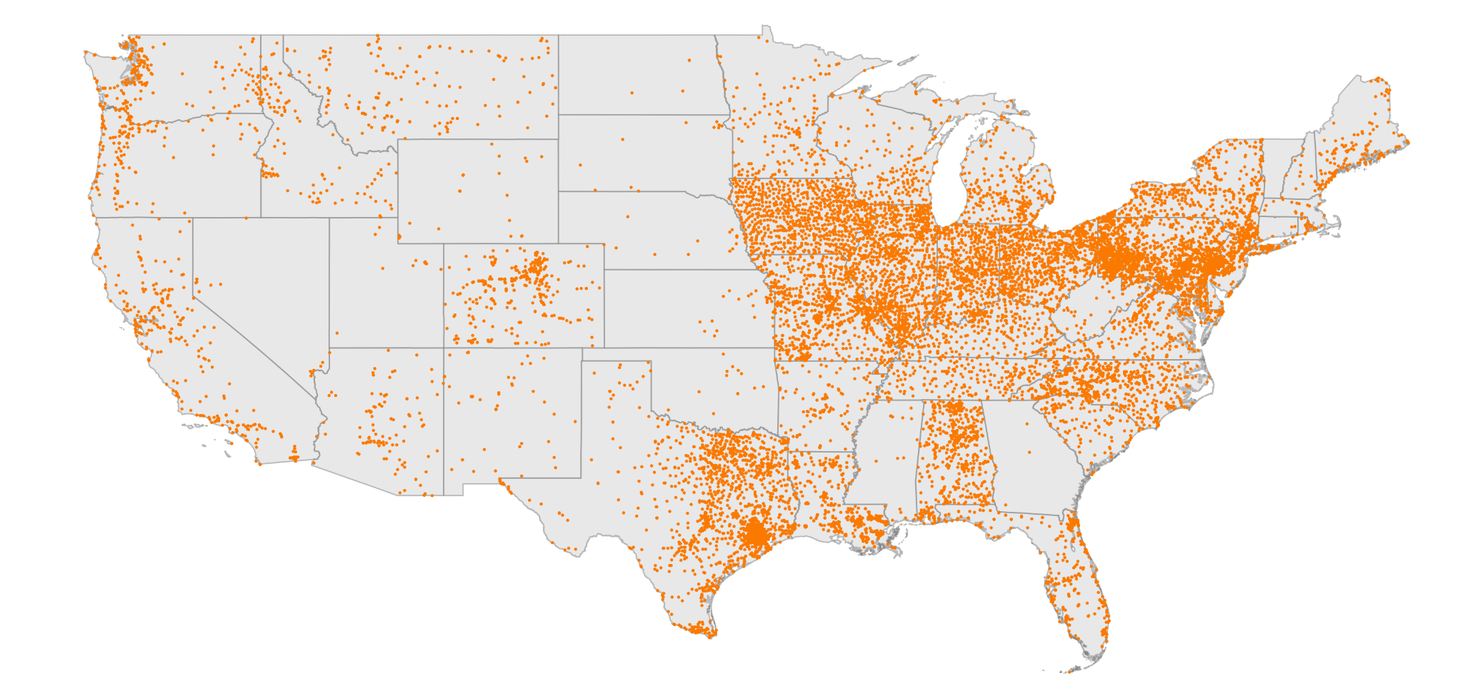
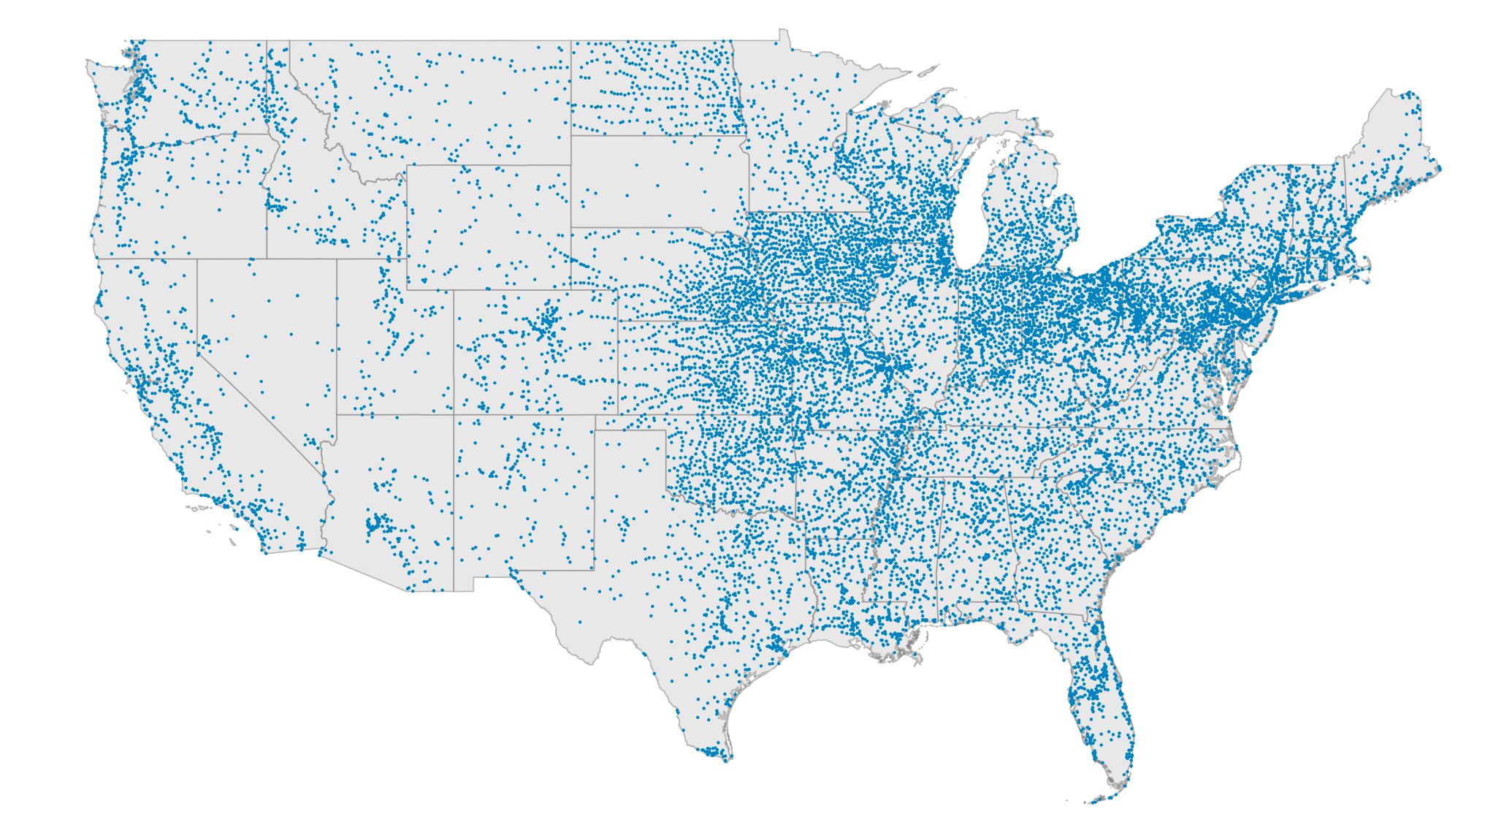
Hydrowaste Data Includes More WWTPs in Certain States Compared to EPA Data
Both Datasets Reflect Higher WWTP Density in Eastern Regions.
EPA data (2020 version, candidate image dataset from last semester)
HydroWASTE data (Newly-obtained dataset, 2012 version EPA + ECHO)

Slide 17
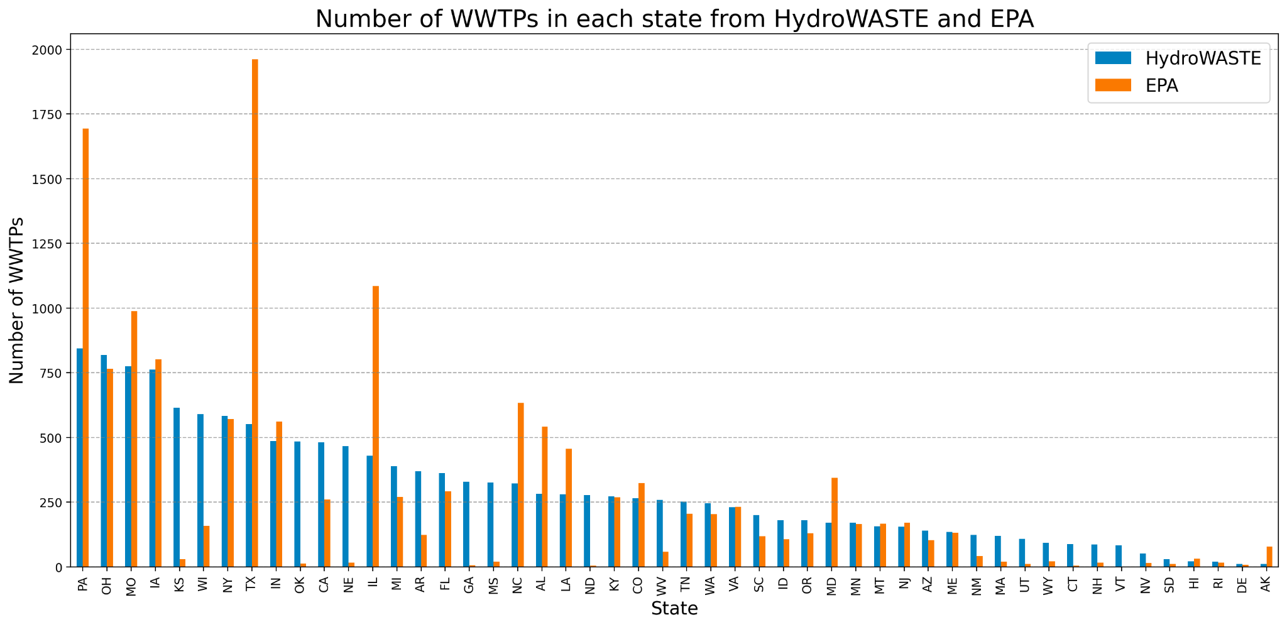
HydroWASTE Outnumbers EPA Data in Majority of States
14,748 total WWTPs from HydroWASTE
14,327 total WWTPs from EPA
34 states where HydroWASTE has more WWTPs than EPA

Slide 18
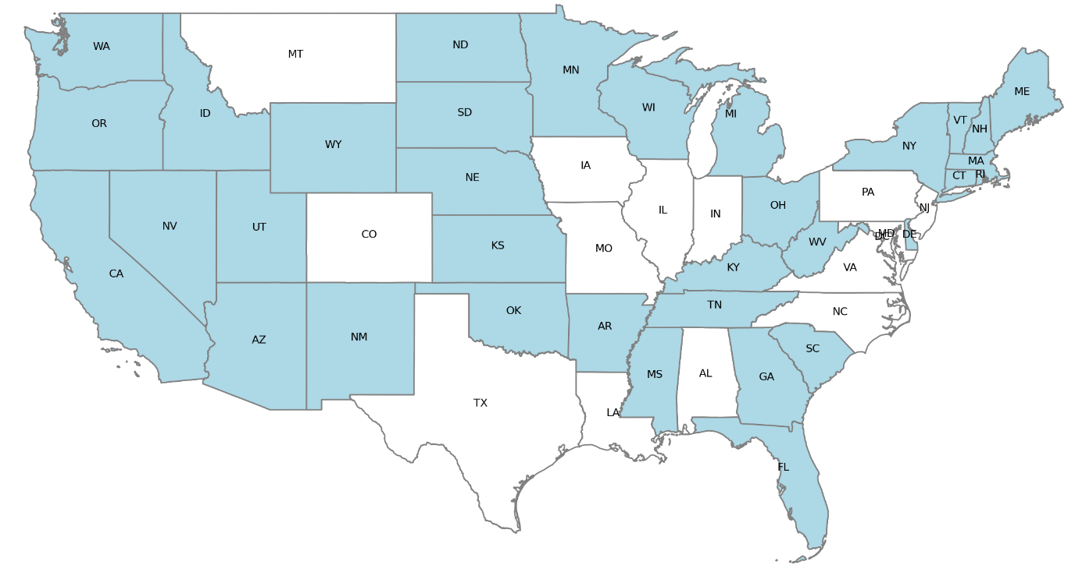
34 States where HydroWASTE has more WWTP than EPA

Slide 19
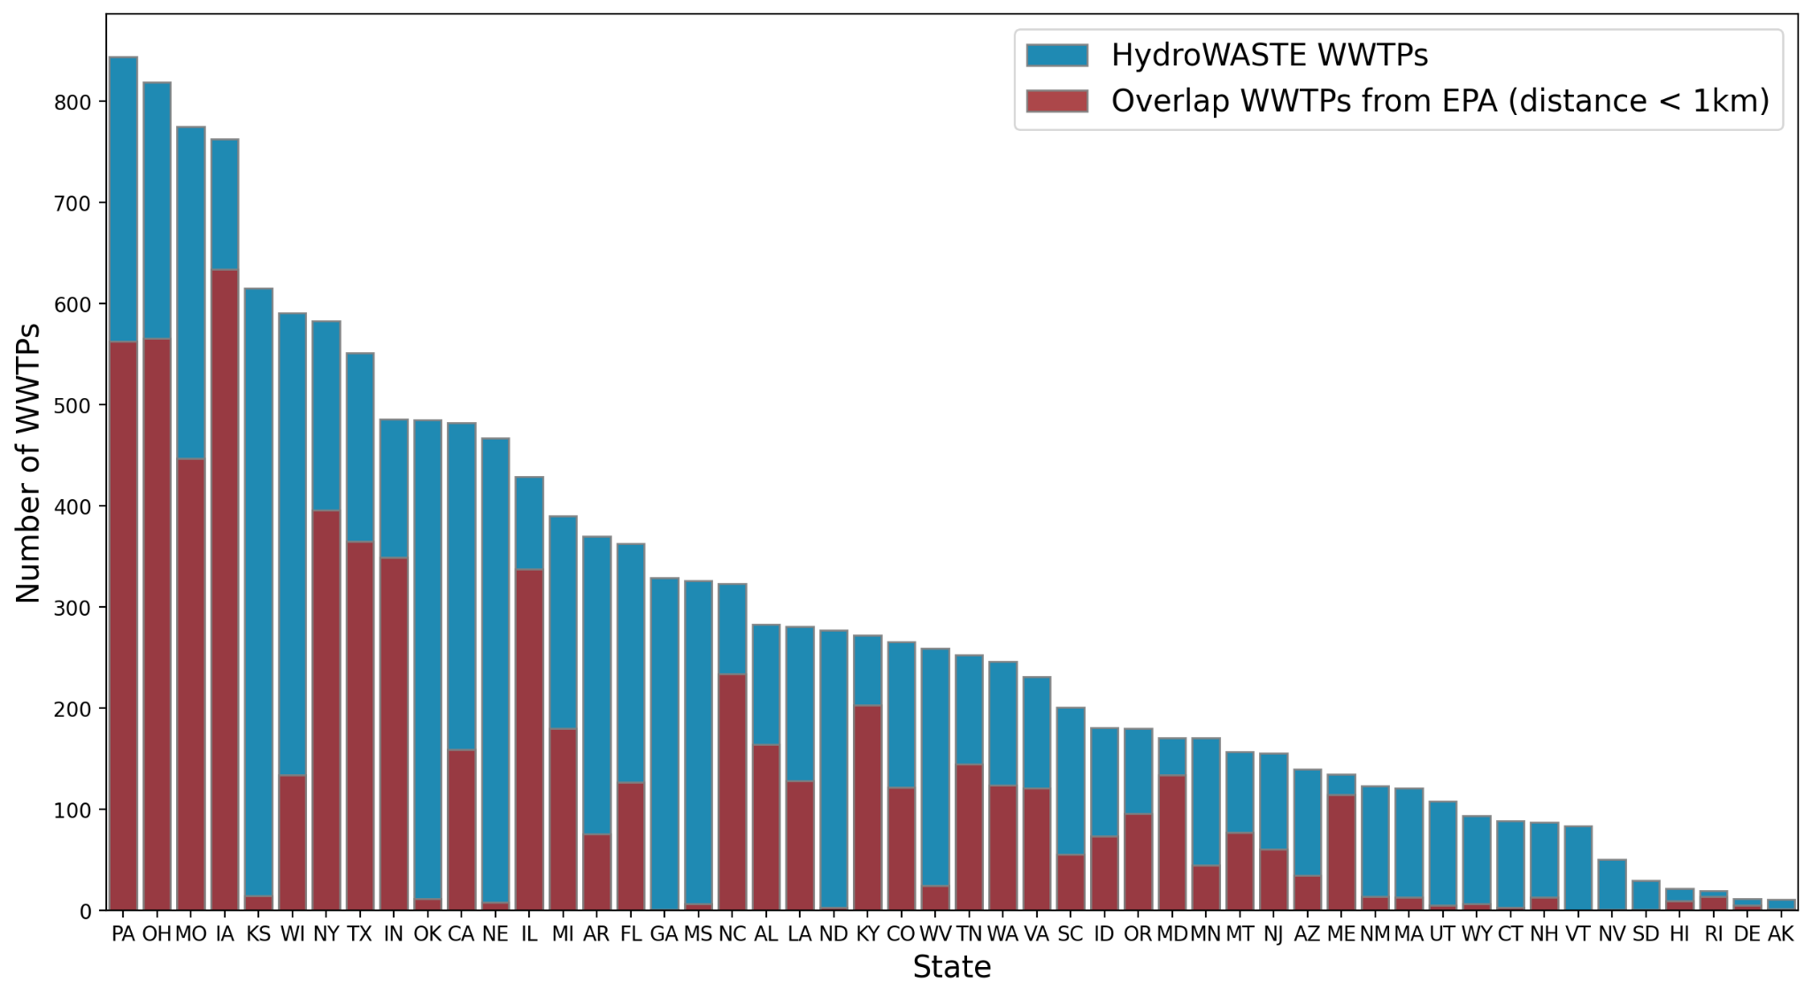
43.58% Overlap Between EPA and HydroWASTE Indicates Significant Value in Combined Coverage
Overlap WWTP is determined by identifying the nearest EPA WWTP to each HydroWASTE entry located within 1 km

Slide 20
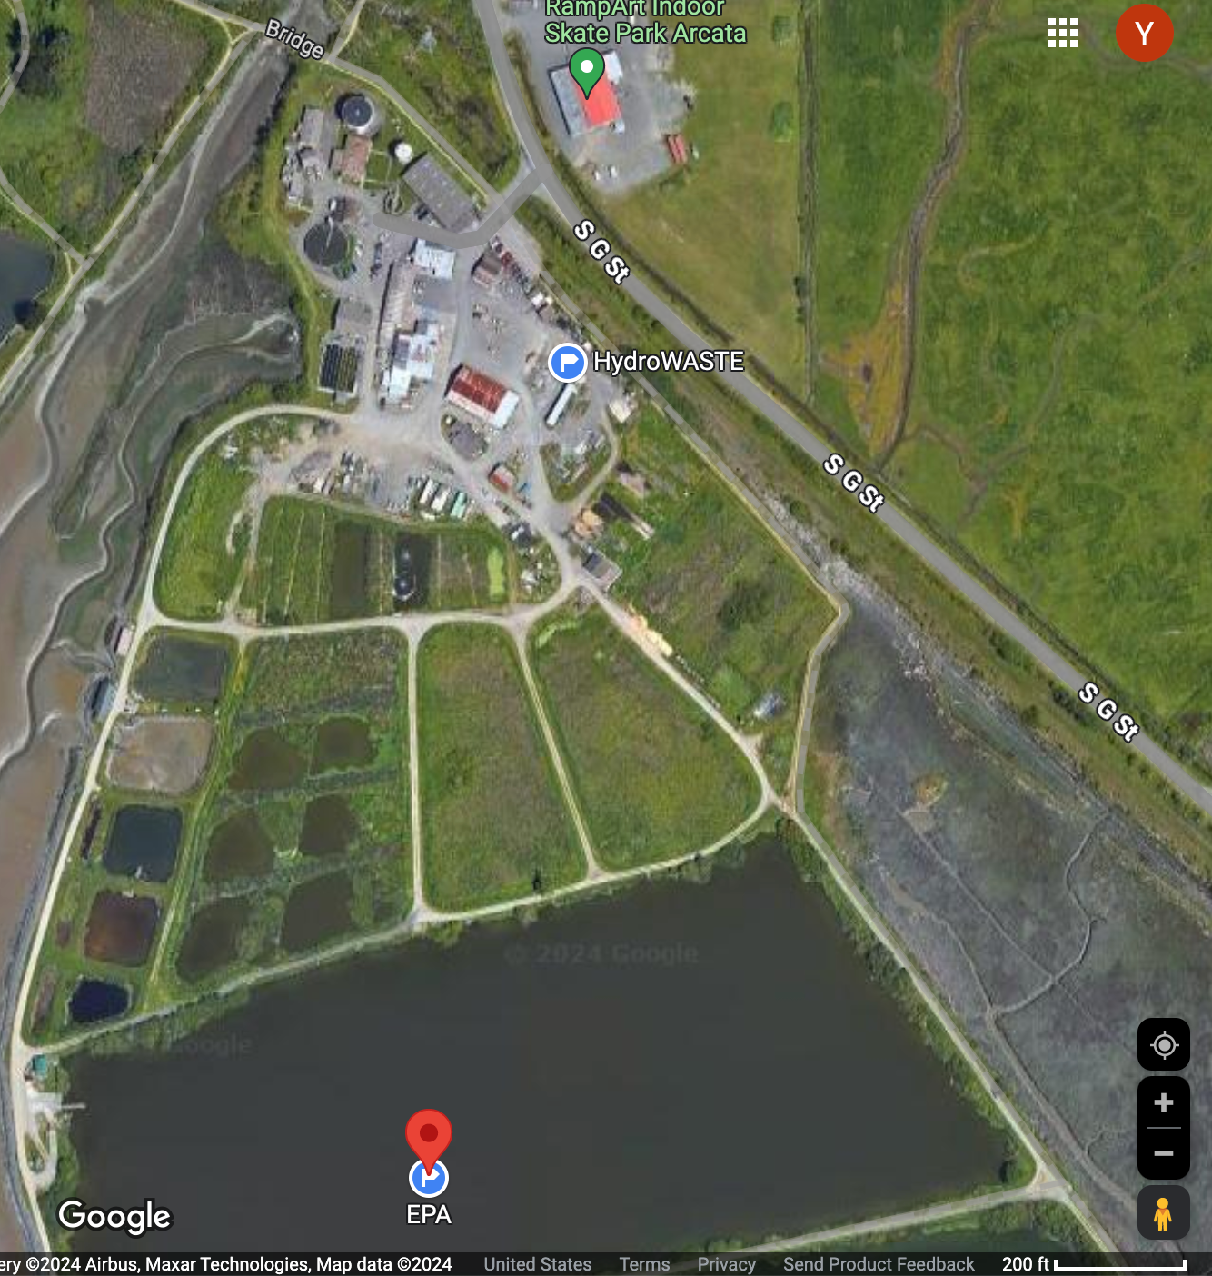
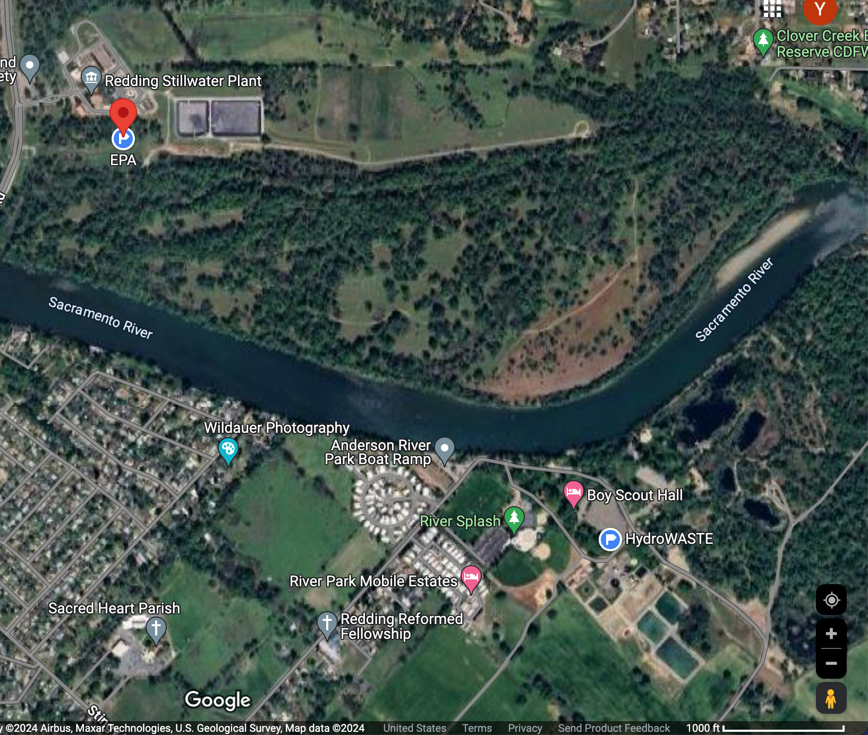
Examples of distance-based criterion for overlap WWTP
In HydroWASTE: Arcata WWTF,
In EPA: ACATA WWTRF
Distance: 0.39 km < 1km
In HydroWASTE: Anderson WWTF
In EPA: STILLWATER WWTF
Distance: 1.6 km > 1km
SAME WWTP
DIFFERENT WWTP

Slide 21
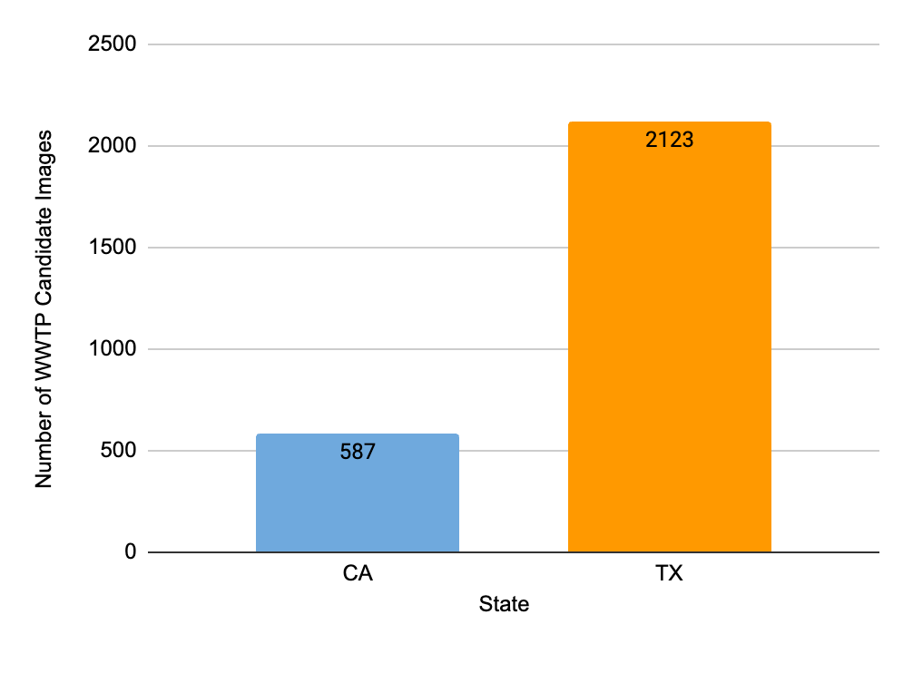
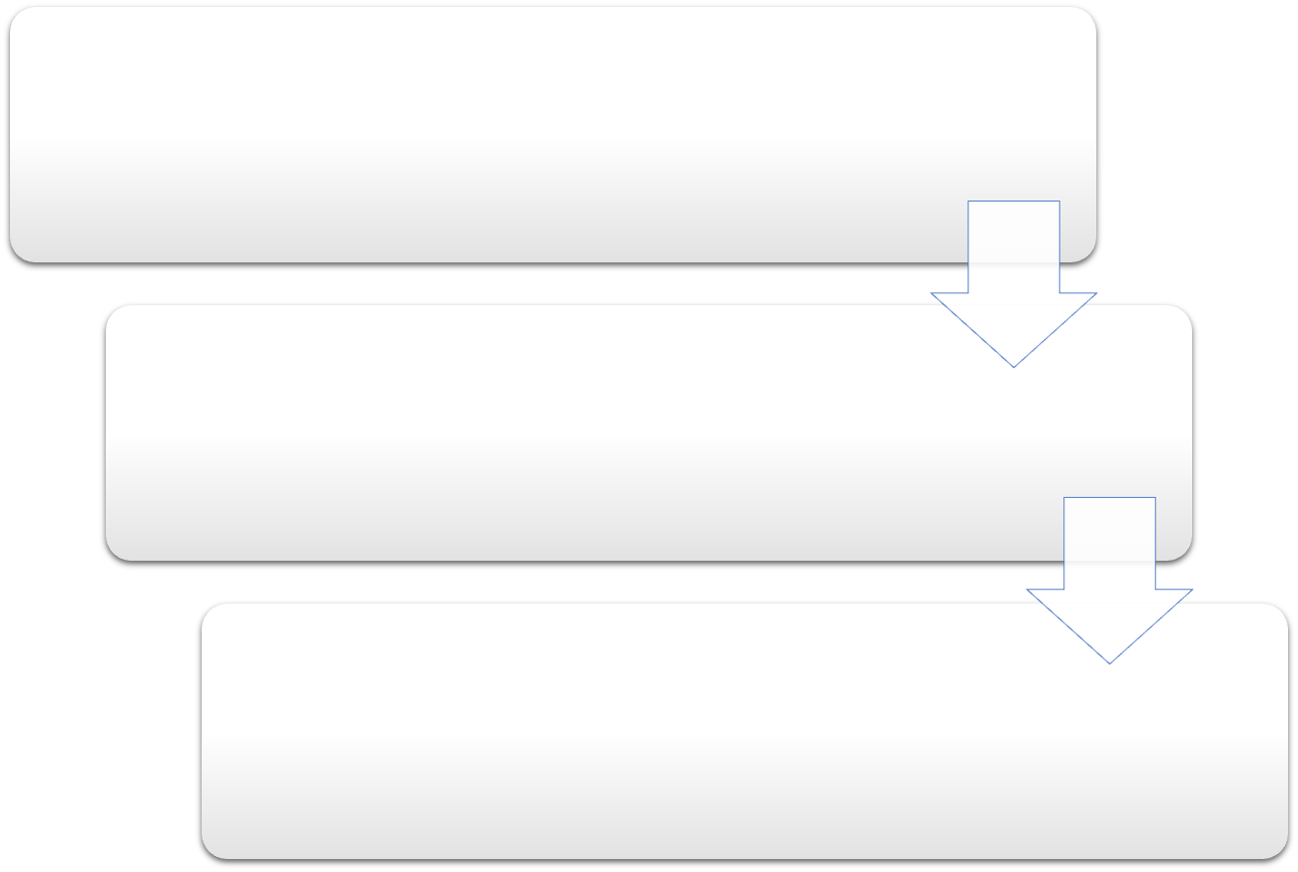
Candidate Image Set: Combined EPA and HydroWASTE after Overlap De-duplication
2710
Merge EPA and HydroWASTE datasets
Deduplicate the WWTP pairs having distance < 1 km (keep the one from HydroWASTE)
22,456 total candidate images in the US (587 in CA, 2123 in TX)

Slide 22
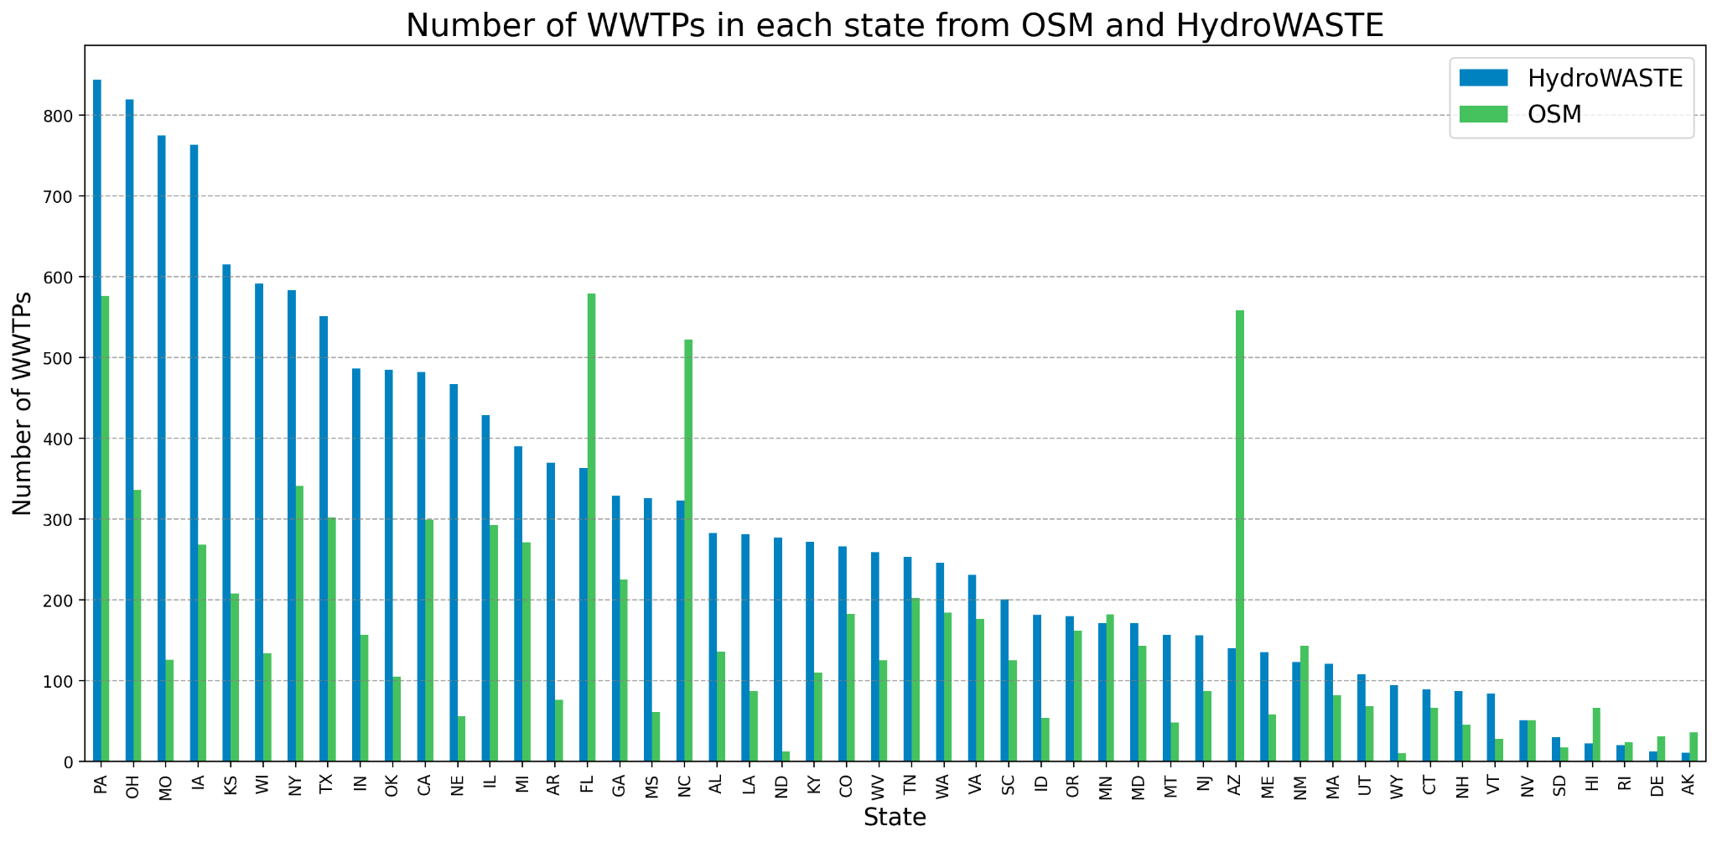
Despite HydroWASTE's Overall Higher WWTP Count, OSM Outnumbers in 9 States
14,748 total WWTPs from HydroWASTE
8,234 total WWTPs from OSM
9 states where OSM has more WWTPs than HydroWASTE

Slide 23
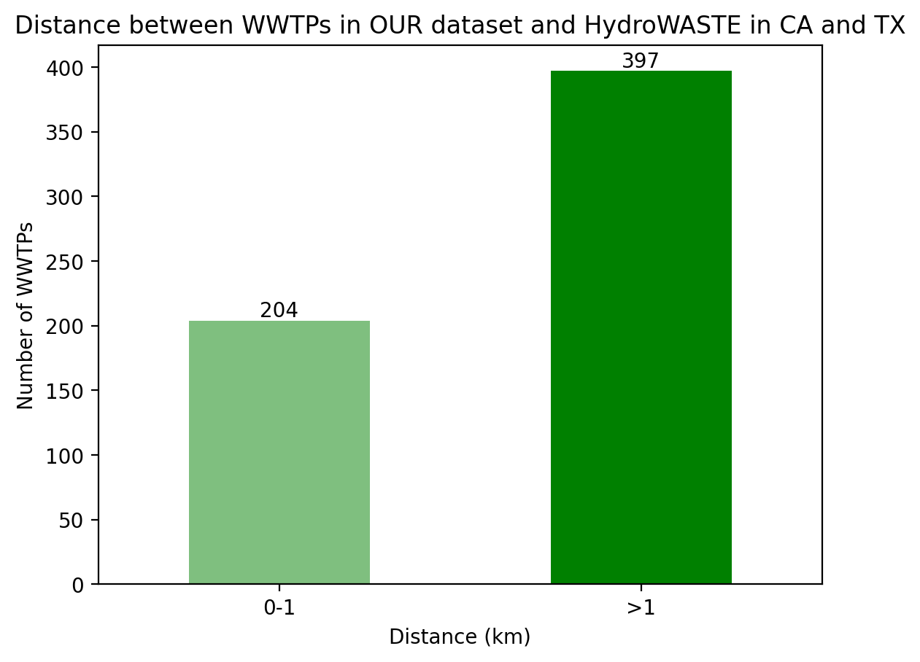
Our dataset and CV model are adding great value – addressing the misclassifications in HydroWASTE and EPA, and enhancing completeness of WWTP lists
Certain entries in HydroWASTE and EPA data are PO boxes or ponds, not actual WWTPs.
66% of WWTPs in CA and TX from our dataset are not covered in HydroWASTE.
Applying our Computer Vision model to HydroWASTE and EPA data enhances the completeness of our WWTP lists while filtering out invalid locations.

Slide 24
Future Roadmap

Slide 25
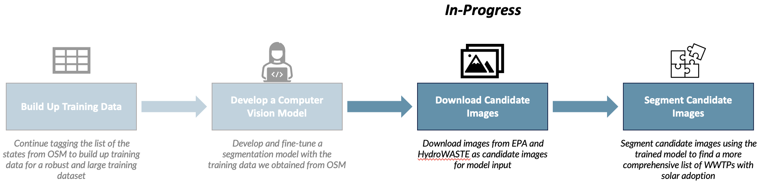
Future Roadmap

Slide 26
Future Model Tuning
Data Preprocessing
Crop image first
Data augmentation techniques
More WWTP data points for training from OSM
Downloading candidate images from merged EPA and Hydrowaste datasets
Other models pre-trained on geospatial data
ResNet 34 and ResNet 50 trained on Sentinel-2
Exploring Object Detection and Image Segmentation Algorithms

Slide 27
Deliverables for Capstone Project
Final Report providing overview of Data Collection, Data Analysis/Exploration, Modeling, and Results
List of WWTP Candidates and verified list based on the model inference
GitHub repository of codebase for replication and further analysis, including fine-tuned weights and Jupyter Notebooks of model implementation
Google Drive of Downloaded WWTP Images and all the slide decks we have

Slide 28
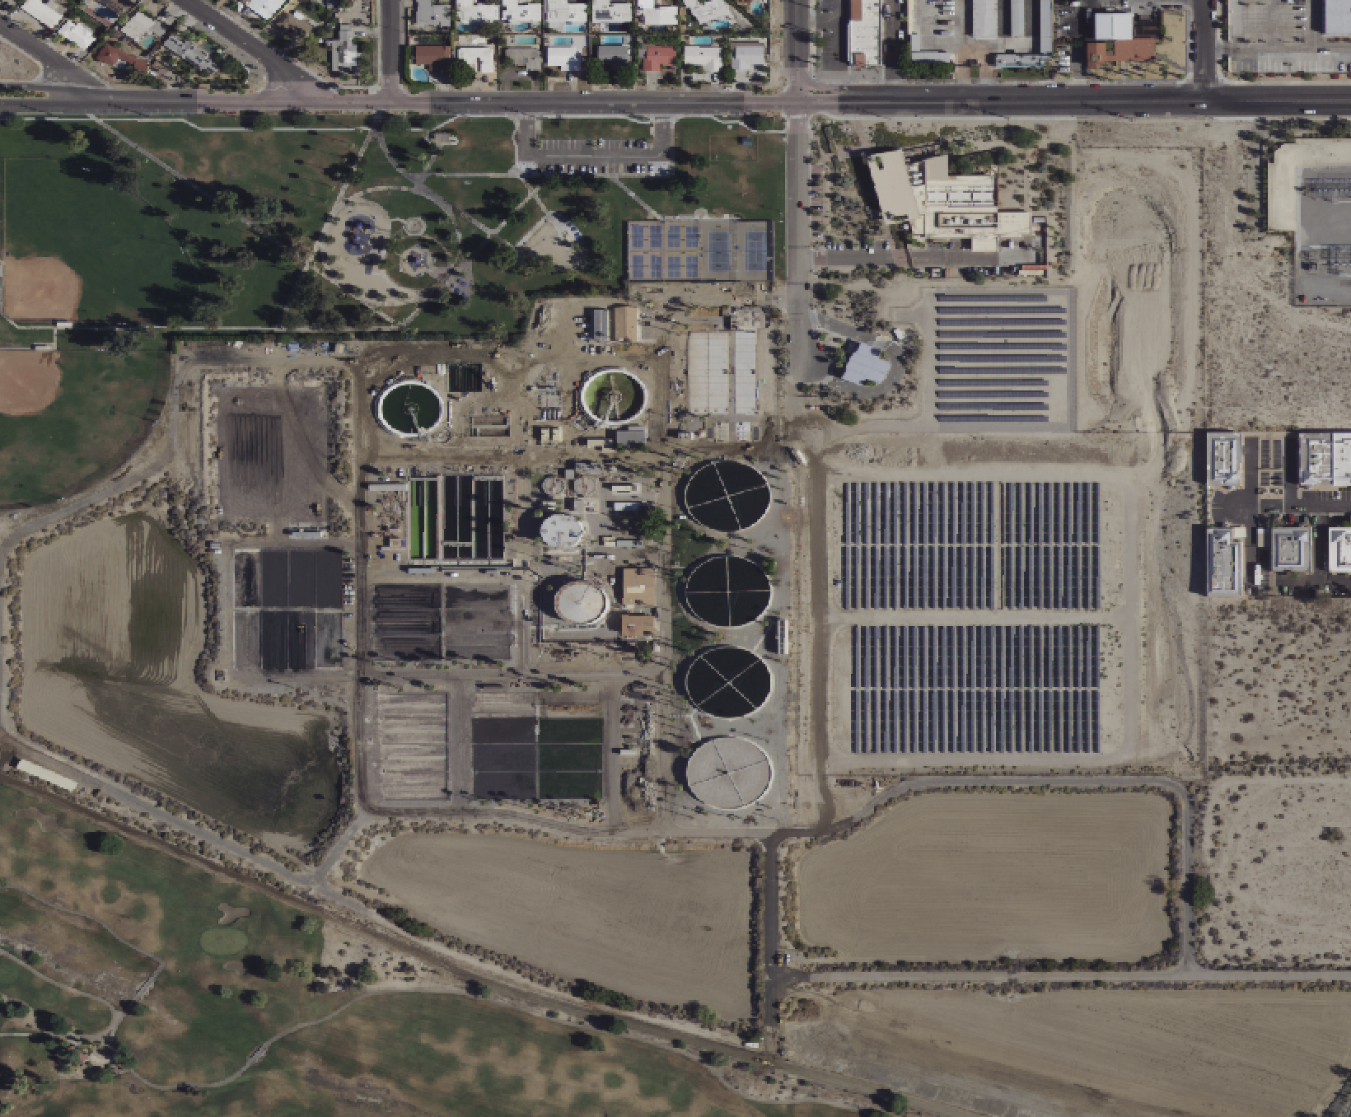
Questions?

